Slide 1


Slide 2
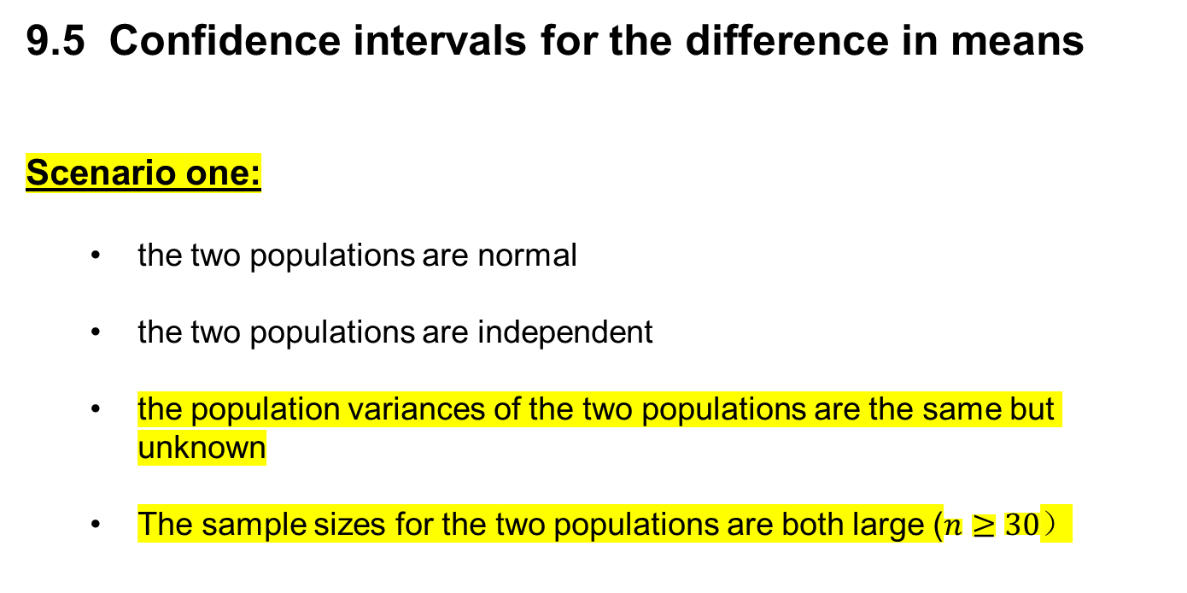
9.5 Confidence intervals for the difference in means
Scenario one:
the two populations are normal
the two populations are independent
the population variances of the two populations are the same but unknown
The sample sizes for the two populations are both large ($n≥30）$

Slide 3
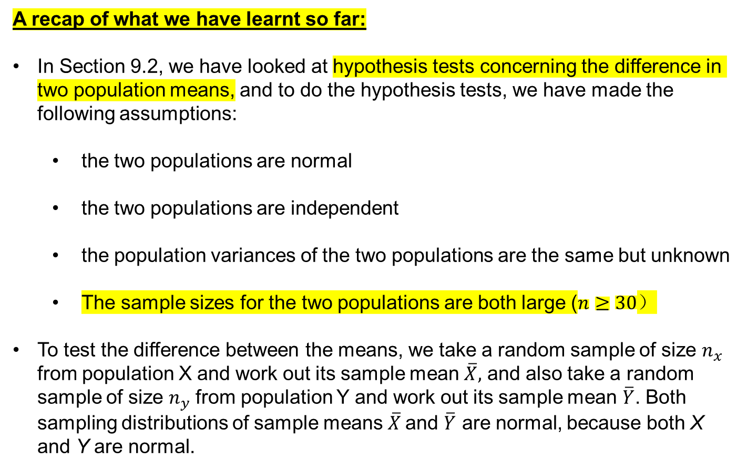
A recap of what we have learnt so far:
In Section 9.2, we have looked at hypothesis tests concerning the difference in two population means, and to do the hypothesis tests, we have made the following assumptions:
the two populations are normal
the two populations are independent
the population variances of the two populations are the same but unknown
The sample sizes for the two populations are both large ($n≥30）$
To test the difference between the means, we take a random sample of size $n_{x}$ from population X and work out its sample mean $\overline{X},$ and also take a random sample of size $n_{y}$ from population Y and work out its sample mean $\overline{Y}$. Both sampling distributions of sample means $\overline{X}$and $\overline{Y}$ are normal, because both X and Y are normal.

Slide 4
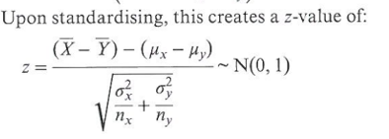
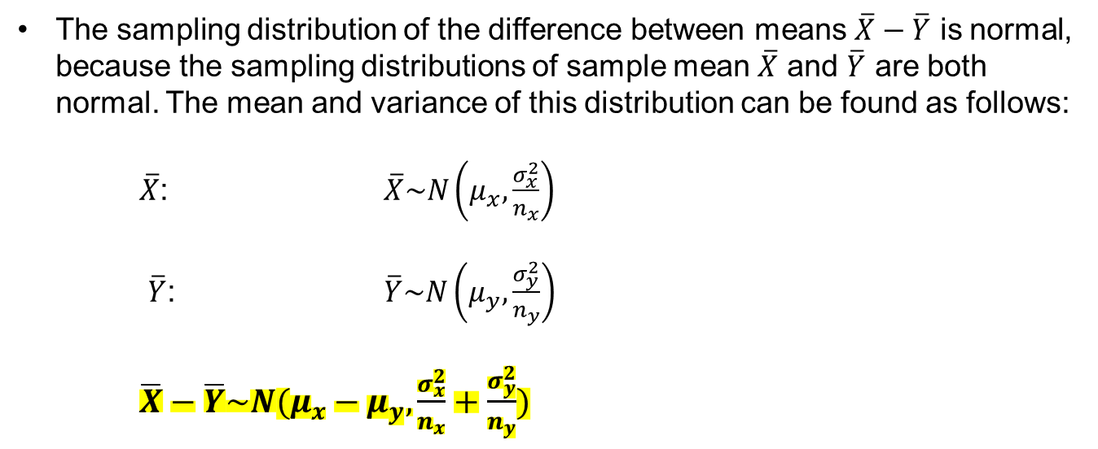
The sampling distribution of the difference between means $\overline{X}−\overline{Y}$ is normal, because the sampling distributions of sample mean $\overline{X}$ and $\overline{Y}$ are both normal. The mean and variance of this distribution can be found as follows:
$\overline{X}$: $\overline{X}\sim N\left(μ_{x}, \frac{σ_{x}^{2}}{n_{x}}\right)$
$\overline{Y}$: $\overline{Y}\sim N\left(μ_{y}, \frac{σ_{y}^{2}}{n_{y}}\right)$
$\overline{X}−\overline{Y}\sim N(μ_{x}−μ_{y}, \frac{σ_{x}^{2}}{n_{x}}+\frac{σ_{y}^{2}}{n_{y}})$

Slide 5
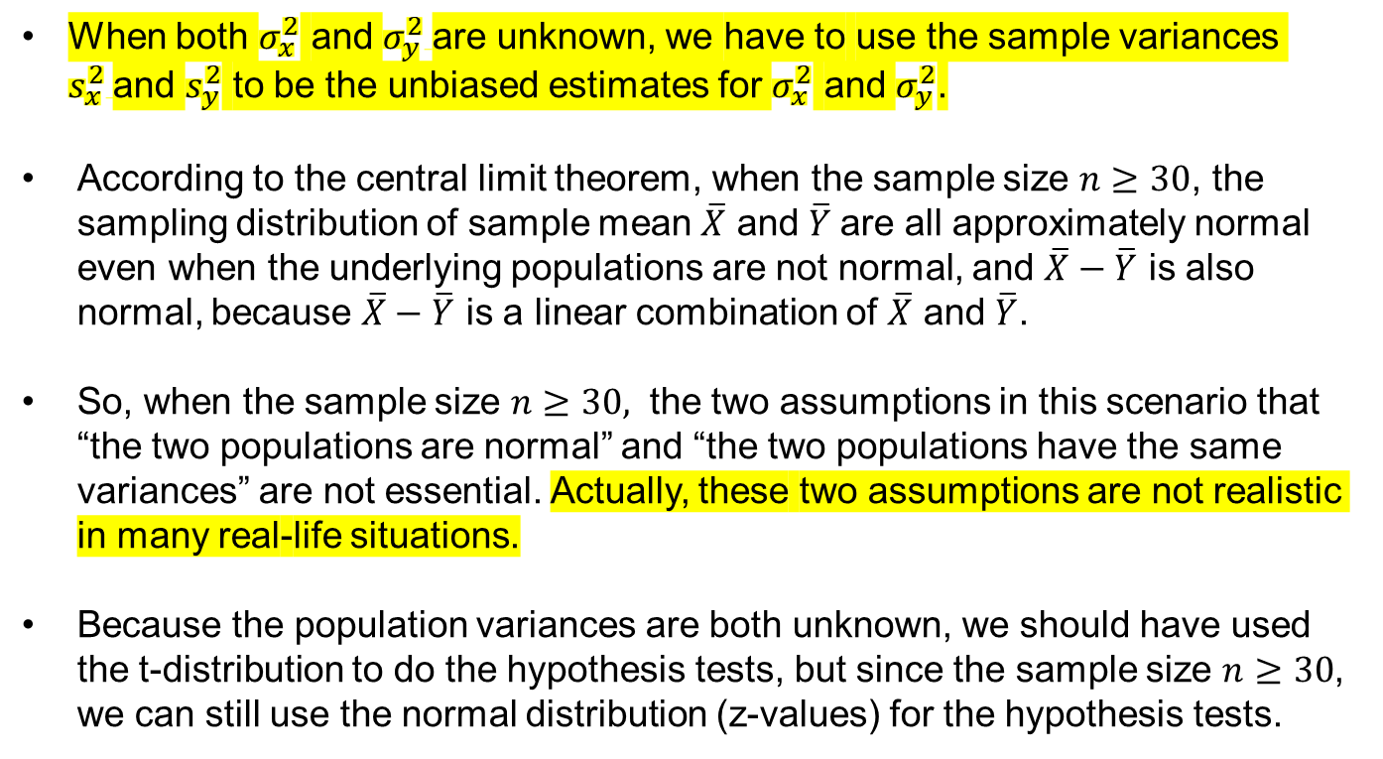
When both $σ_{x}^{2}$ and $σ_{y}^{2}$are unknown, we have to use the sample variances $s_{x}^{2}$and $s_{y}^{2}$ to be the unbiased estimates for $σ_{x}^{2}$ and $σ_{y}^{2}$.
According to the central limit theorem, when the sample size $n≥30$, the sampling distribution of sample mean $\overline{X}$ and $\overline{Y}$are all approximately normal even when the underlying populations are not normal, and $\overline{X}−\overline{Y}$ is also normal, because $\overline{X}−\overline{Y}$ is a linear combination of $\overline{X}$ and $\overline{Y}$.
So, when the sample size $n≥30,$ the two assumptions in this scenario that “the two populations are normal” and “the two populations have the same variances” are not essential. Actually, these two assumptions are not realistic in many real-life situations.
Because the population variances are both unknown, we should have used the t-distribution to do the hypothesis tests, but since the sample size $n≥30$, we can still use the normal distribution (z-values) for the hypothesis tests.

Slide 6
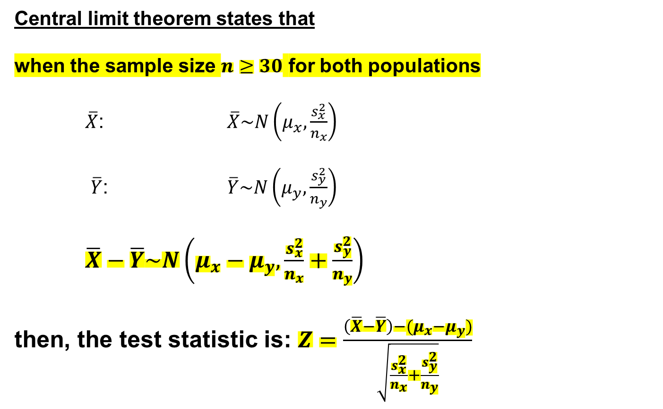
Central limit theorem states that
when the sample size $n≥30$ for both populations
$\overline{X}$: $\overline{X}\sim N\left(μ_{x}, \frac{s_{x}^{2}}{n_{x}}\right)$
$\overline{Y}$: $\overline{Y}\sim N\left(μ_{y}, \frac{s_{y}^{2}}{n_{y}}\right)$
$\overline{X}−\overline{Y}\sim N\left(μ_{x}−μ_{y}, \frac{s_{x}^{2}}{n_{x}}+\frac{s_{y}^{2}}{n_{y}}\right)$
then, the test statistic is: $Z=\frac{\left(\overline{X}−\overline{Y}\right)−(μ_{x}−μ_{y})}{\sqrt{\frac{s_{x}^{2}}{n_{x}}+\frac{s_{y}^{2}}{n_{y}}}}$

Slide 7
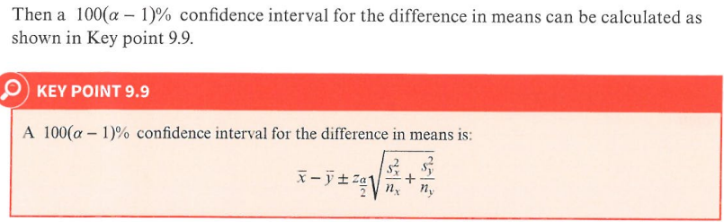
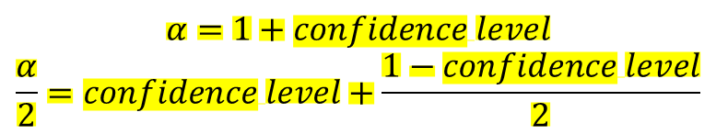

$$n≥30$$
$$α=1+confidence level$$
$$\frac{α}{2}=confidence level+\frac{1−confidence level}{2}$$

Slide 8
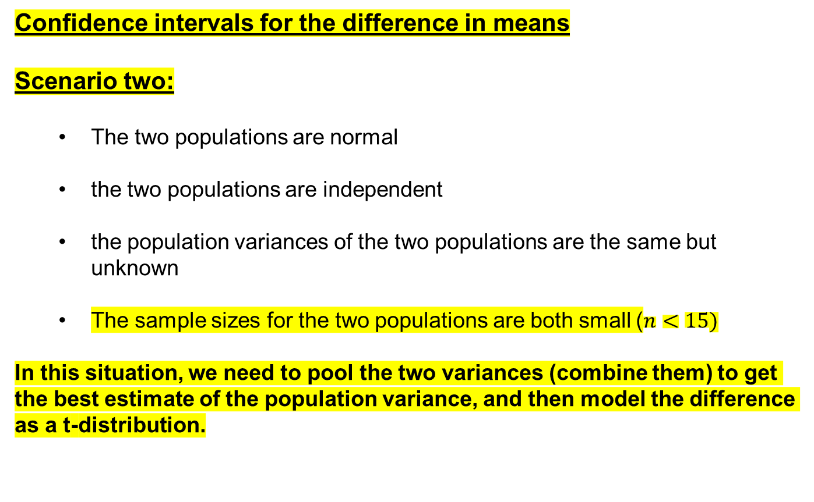
Confidence intervals for the difference in means
Scenario two:
The two populations are normal
the two populations are independent
the population variances of the two populations are the same but unknown
The sample sizes for the two populations are both small ($n<15)$
In this situation, we need to pool the two variances (combine them) to get the best estimate of the population variance, and then model the difference as a t-distribution.

Slide 9

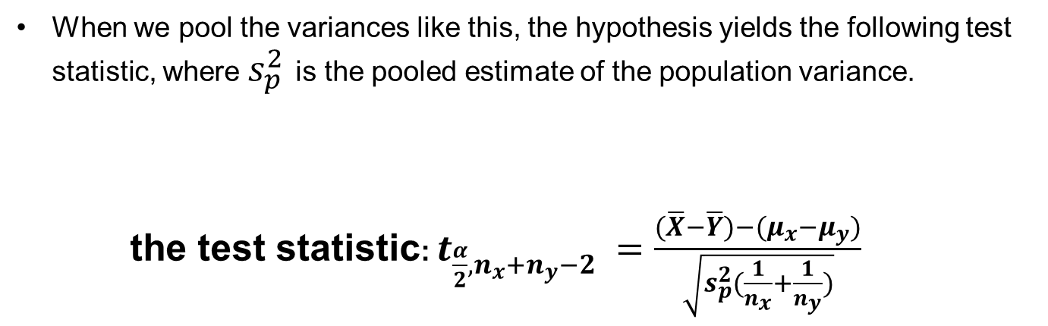
When we pool the variances like this, the hypothesis yields the following test statistic, where $s_{p}^{2}$ is the pooled estimate of the population variance.
the test statistic: $t_{\frac{α}{2}, n_{x}+n_{y}−2} =\frac{(\overline{X}−\overline{Y})−(μ_{x}−μ_{y})}{\sqrt{s_{p}^{2}(\frac{1}{n_{x}}+\frac{1}{n_{y}})}}$
$$n<15$$

Slide 10
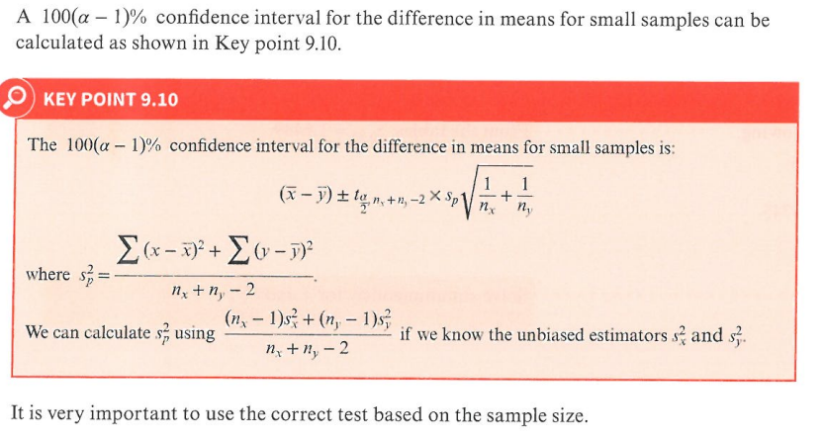


$$n<15$$
$$α=1+confidence level$$
$$\frac{α}{2}=confidence level+\frac{1−confidence level}{2}$$

Slide 11
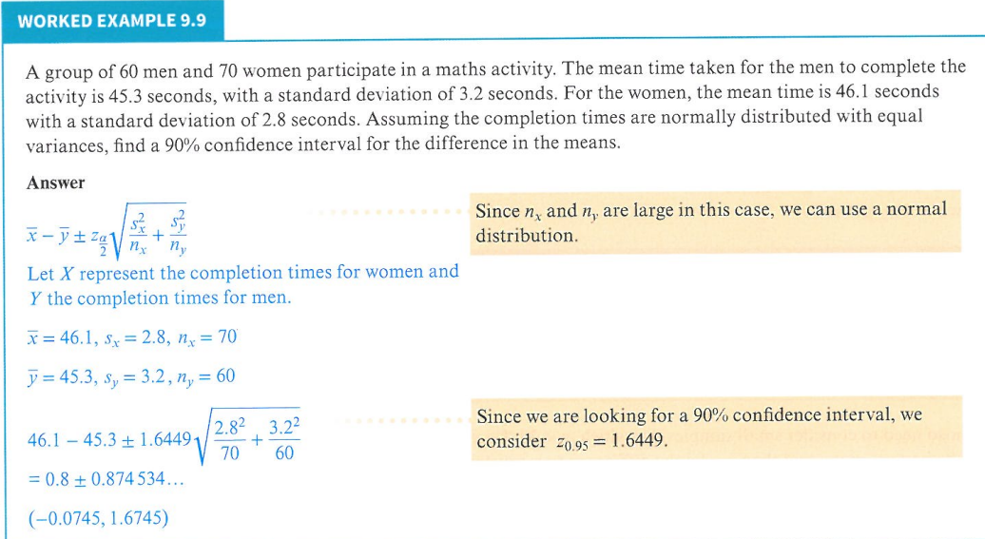
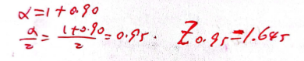

$$n≥30$$

Slide 12
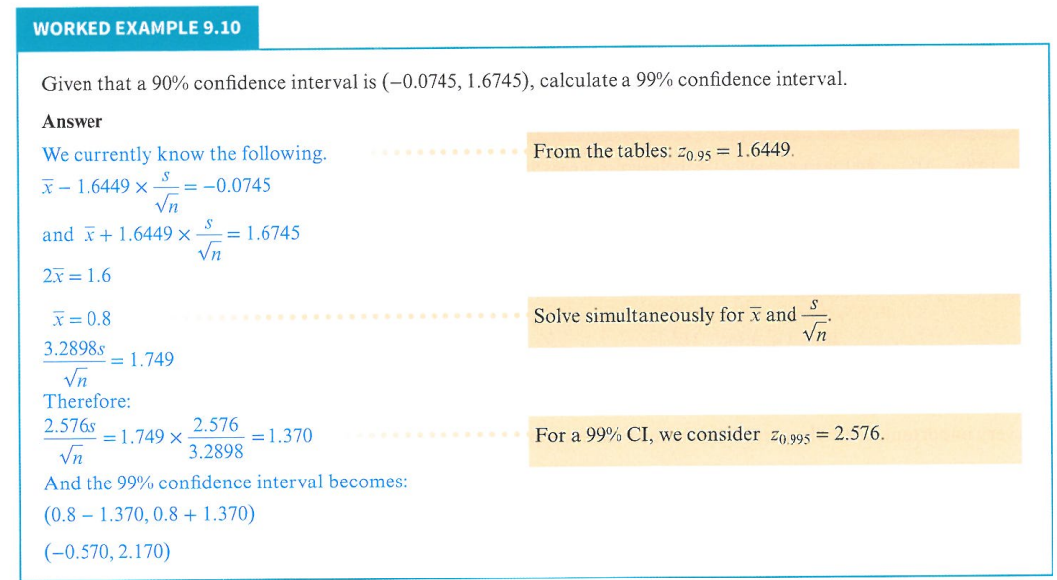
Width of CI

Slide 13
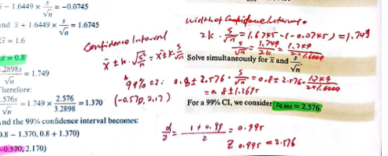

Slide 14
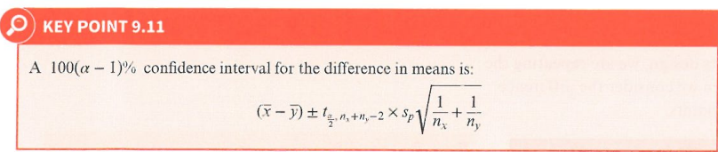
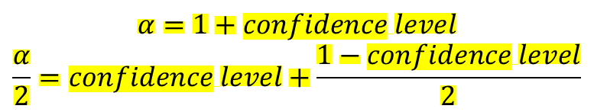

$$\text{Small} \text{samples}$$
$$n<15$$
$$α=1+confidence level$$
$$\frac{α}{2}=confidence level+\frac{1−confidence level}{2}$$

Slide 15
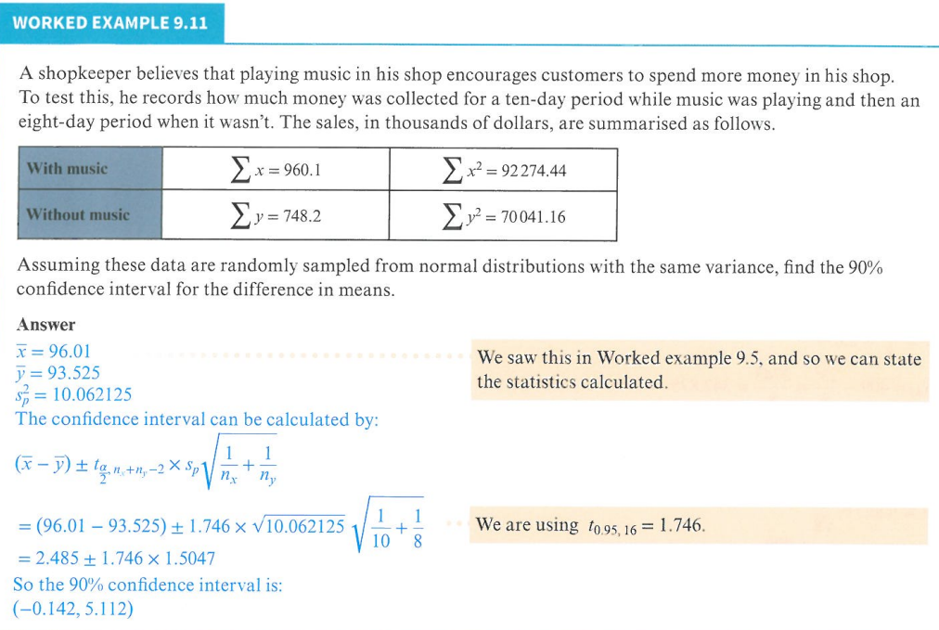
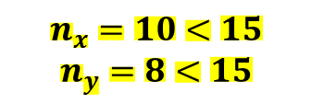
$$n_{x}=10<15$$
$$n_{y}=8<15$$

Slide 16
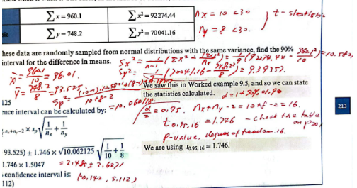

Slide 17
Confidence intervals for the paired samples
In the Section 9.3, we have looked at the hypothesis tests for the paired samples.
Now we will look at how to construct confidence intervals for the paired samples.
Consider a situation where we need to measure the effect of a variable on a set of data, then we measure twice: before the change in variable, and after. This repeated measures design allows us to pair the points in the two datasets. In this situation, a paired t-test would be the most appropriate test to perform.
In a paired test, the same set of samples is tested in two conditions.
In a paired t-test, instead of measuring the difference in the means, we measure the mean of the differences.

Slide 18
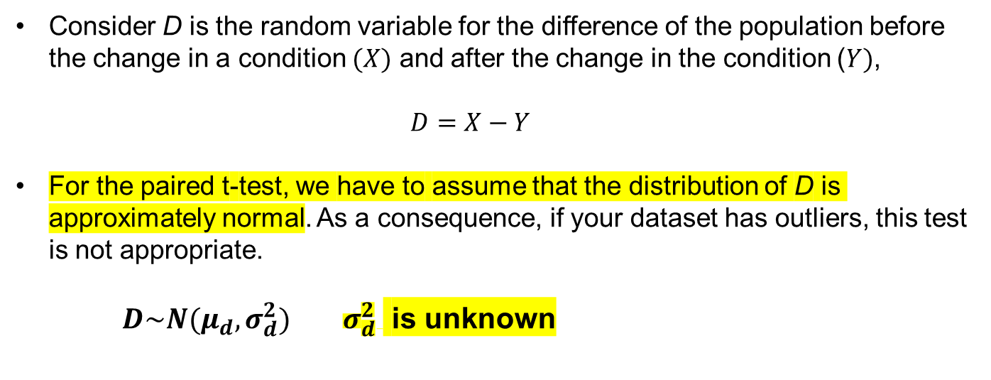
Consider D is the random variable for the difference of the population before the change in a condition $(X)$ and after the change in the condition ($Y)$,
$$D=X−Y$$
For the paired t-test, we have to assume that the distribution of D is approximately normal. As a consequence, if your dataset has outliers, this test is not appropriate.
$D\sim N(μ_{d}, σ_{d}^{2})$ $σ_{d}^{2}$ is unknown

Slide 19
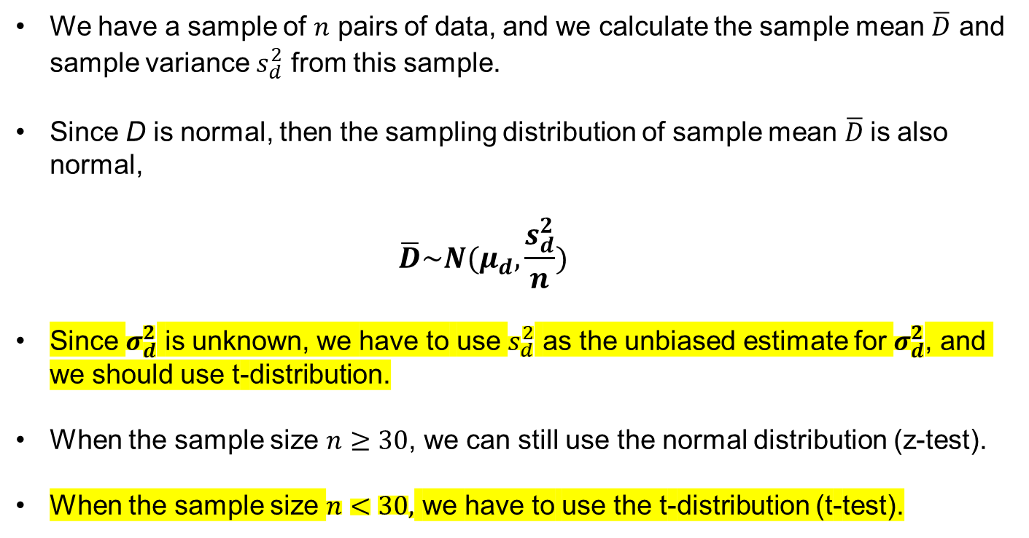
We have a sample of $n$ pairs of data, and we calculate the sample mean $\overline{D}$ and sample variance $s_{d}^{2}$ from this sample.
Since D is normal, then the sampling distribution of sample mean $\overline{D}$is also normal,
$$\overline{D}\sim N(μ_{d},\frac{s_{d}^{2}}{n})$$
Since $σ_{d}^{2}$ is unknown, we have to use $s_{d}^{2}$ as the unbiased estimate for $σ_{d}^{2}$, and we should use t-distribution.
When the sample size $n≥30$, we can still use the normal distribution (z-test).
When the sample size $n<30,$ we have to use the t-distribution (t-test).

Slide 20

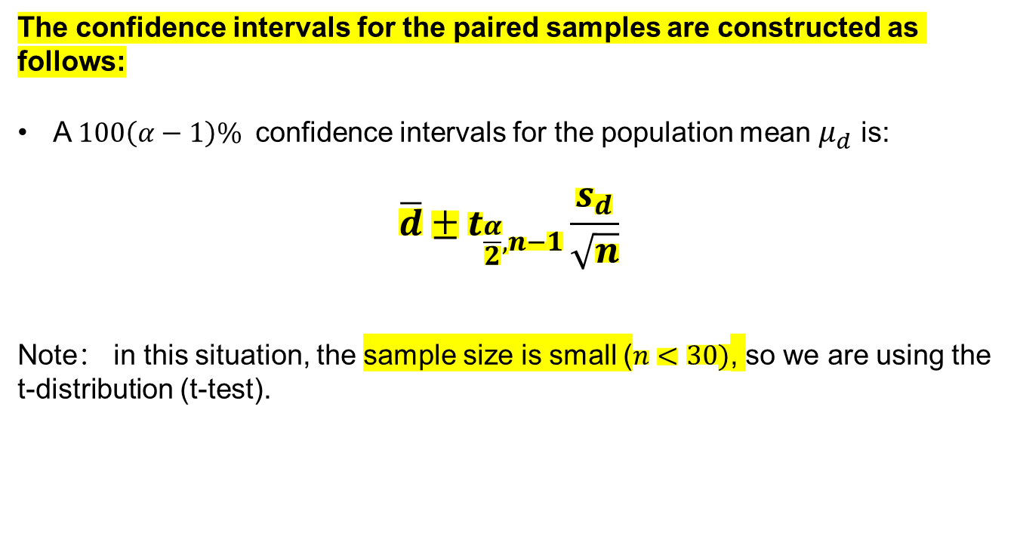
The confidence intervals for the paired samples are constructed as follows:
A $100\left(α−1\right)\%$ confidence intervals for the population mean $μ_{d}$ is:
$$\overline{d}±t_{\frac{α}{2},n−1}\frac{s_{d}}{\sqrt{n}}$$
Note： in this situation, the sample size is small ($n<30)$, so we are using the t-distribution (t-test).
$$α=1+confidence level$$
$$\frac{α}{2}=confidence level+\frac{1−confidence level}{2}$$

Slide 21
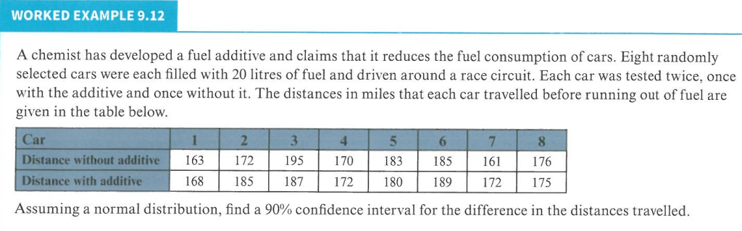
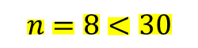
$$n=8<30$$

Slide 22
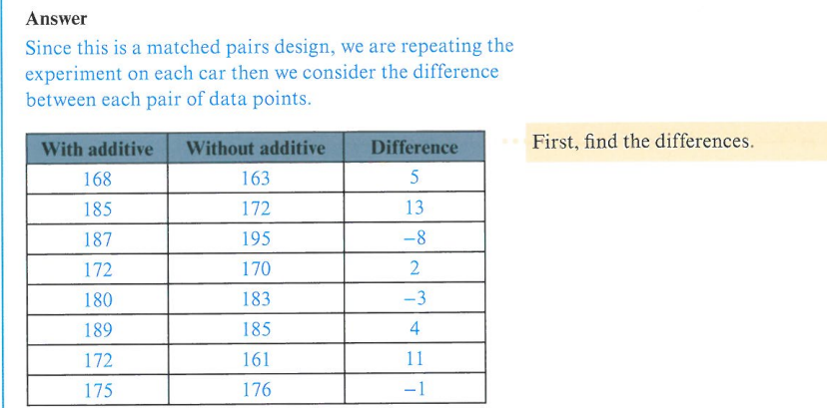

Slide 23
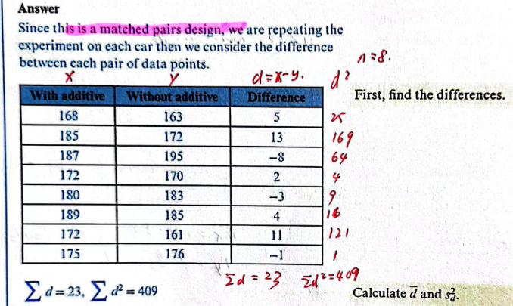

Slide 24
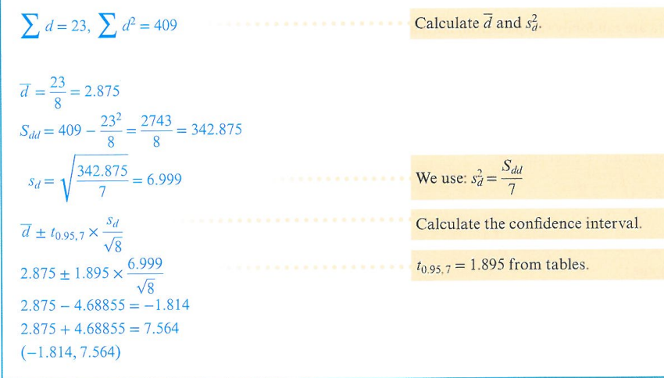

Slide 25
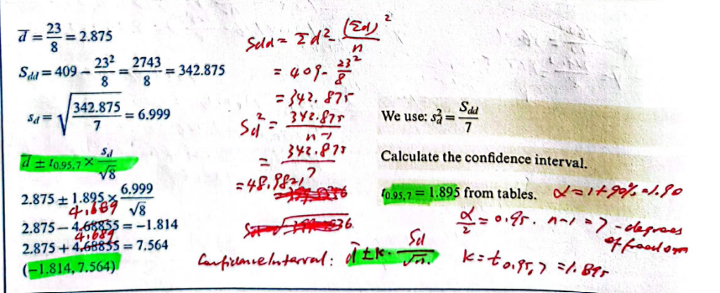

Slide 26
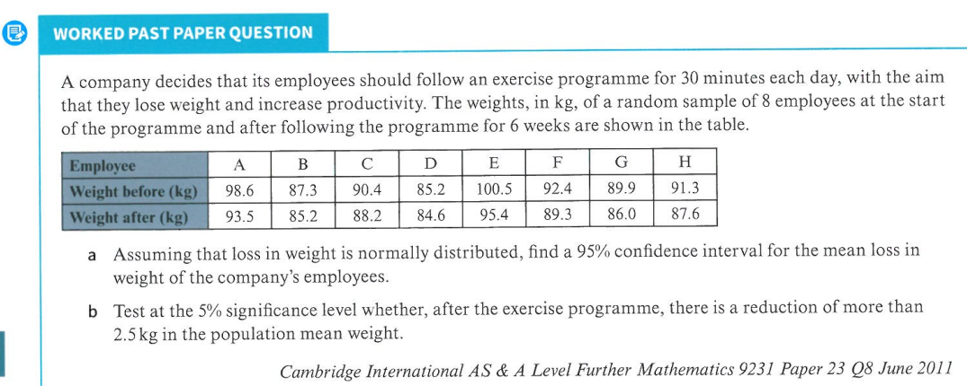

X
Y
$$n=8<30$$

Slide 27
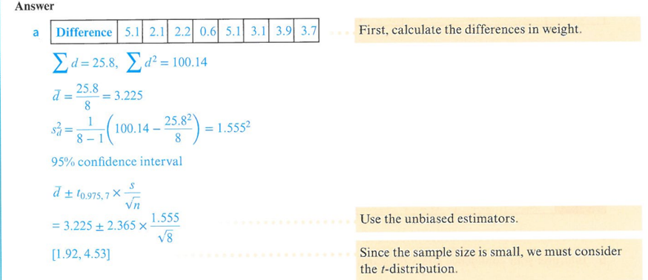

Slide 28
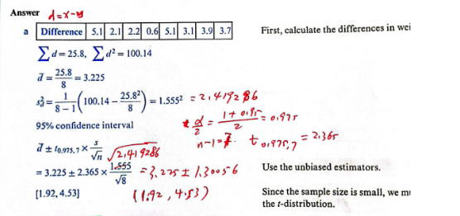

Slide 29
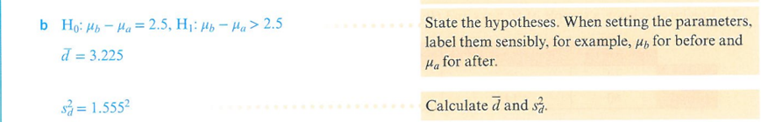
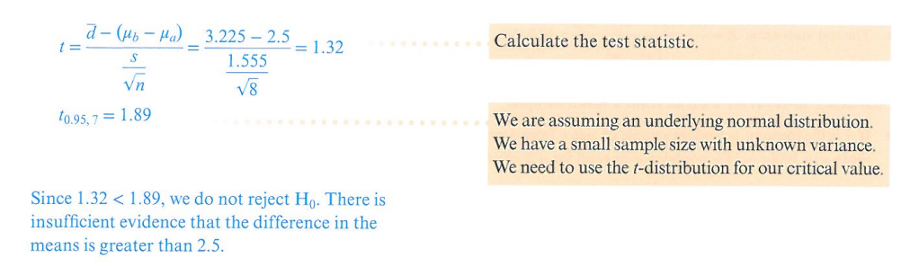

We accept $H_{0}$

Slide 30
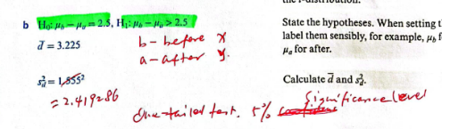
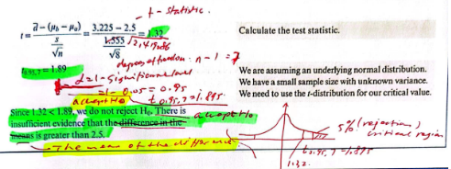

Slide 31
Practice Time!

Slide 32
Exercise 9E
In class 1,2,3,4
Homework 5,6,7,8

Slide 33
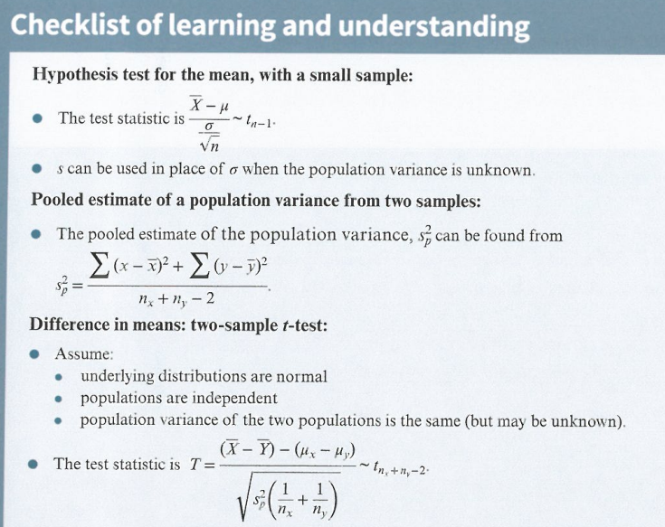

Slide 34
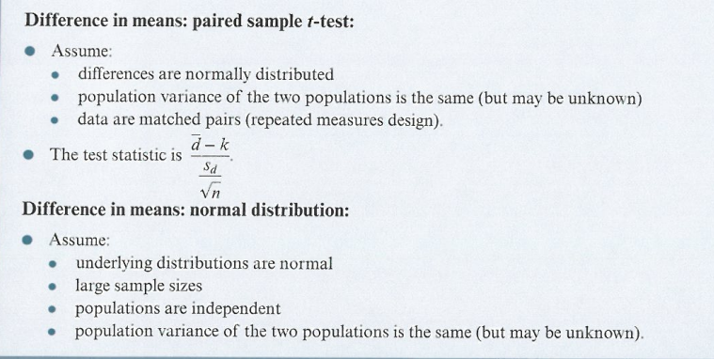

Slide 35
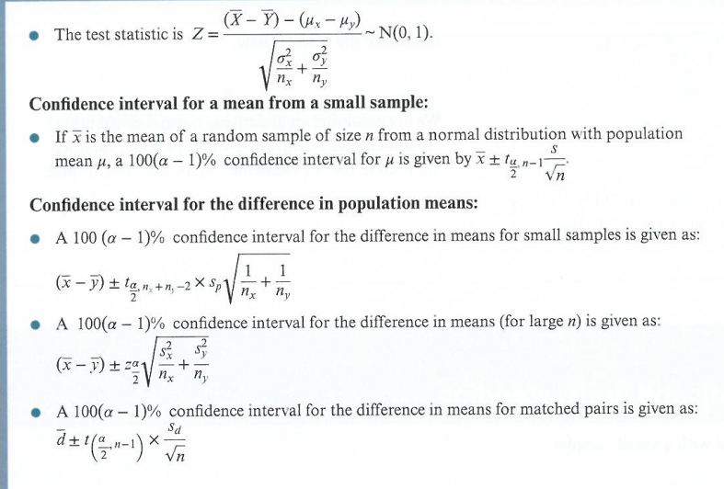

Slide 36
The End
Thank You

